Slide 1
The New York State Program for the Conservation and Preservation of Library Research Materials
The Discretionary Grant Application Process

Slide 2
The New York State Program for the Conservation and Preservation of Library Research Materials
Barbara Lilley
Library Development Specialist II
Division of Library Development
Phone: (518) 486-4864
Holly Peacock
Education Finance Specialist
Division of Library Development
Phone (518)-486-2197
e-mail: preservation@nysed.gov ( C/P grant questions)
barbara.lilley@nysed.gov ( C/P program questions)
https://www.nysl.nysed.gov/libdev/cp/index.html

Slide 3
ELIGIBILITY
Eligible agencies include those that have been:
chartered by the Board of Regents of the State of New York; OR
accepted by the Board of Regents for filing under not-for-profit sections (section 216) of the Education Law; OR
registered with the office of Charities of the New York State Department of State; OR
granted not-for-profit status under section 501(c)(3) of the United States Internal Revenue code.

Slide 4
NOT ELIGIBLE
The 11 designated comprehensive research libraries
Institutions wholly or in part under the control of direction of any religious denomination, in which any denominational tenet of doctrine is taught, are constitutionally ineligible to receive State financial assistance.
New York State agencies and collections which are part of State agencies, including New York State Historic Sites. However, State University of New York (SUNY) colleges are eligible to receive discretionary grant funds.

Slide 5
Eligible Expenditures
Expenditures may include:
personnel costs
service and consultant contracts
supplies and equipment for project activities, or other activities
All expenditures of discretionary grant funds, whether for personnel, contracted services, supplies, equipment, or others, must be for preservation activities described under FUNDABLE ACTIVITIES

Slide 6
Ineligible Expenditures
Funds will not be awarded for activities or expenditures judged to be the ordinary responsibility of the institution. These activities include (among others):
General operating expenses, indirect costs or overhead charges
the acquisition of library research materials in any format, either to add to the collection or to replace deteriorated materials by purchase of reprints or microforms
capital expenditures for building construction or modification
providing standard library shelving
physical processing
basic disaster planning
microform readers
computer equipment
basic security measures such as burglar alarms, locks, fire extinguishers, etc.
salaries and/or benefits for existing personnel

Slide 7
FUNDABLE ACTIVITIES Planning & Screening
Includes:
Item level surveys
DHPSNY.ORG
Does NOT Include:
Initial preservation planning

Slide 8
FUNDABLE ACTIVITIES Environmental Controls & Storage
Includes:
Upgrading mechanical HVAC
Special shelving or storage furnishings
Does NOT include:
Stop-gap measures
Standard library shelving

Slide 9
FUNDABLE ACTIVITIES Reformatting- Microforms
Includes:
Preservation quality microfilm
Preservation quality microfiche
Color microforms
Does NOT include:
Microform readers or readers/printers

Slide 10
FUNDABLE ACTIVITIES Reformatting- Non-microforms
Includes:
Photographic negative duplication
Copy prints of photographic images
Sound recordings
Photocopying (sometimes)
Does NOT include:
Digitization
Video tapes
Cassette tapes
Photocopying (usually)

Slide 11
FUNDABLE ACTIVITIES Physical Treatment
Includes:
Collection cleaning projects
Protective enclosures
Rebinding, minor repairs & mending
Major conservation treatments
Does NOT include:
Basic housekeeping
Physical processing
Learning-by-doing projects

Slide 12
FUNDABLE ACTIVITIES Bibliographic Activities
Includes:
Limited to 10% of the grant award
Only when closely connected to preservation work itself

Slide 13
FUNDABLE ACTIVITIES Other Fundable Activities
Includes:
Disaster recovery
Research
Specialized training
Preservation Informational materials
Does NOT include:
Preparing disaster plans
Purchasing emergency supplies
Exhibitions
Publishing guides or catalogs

Slide 14
The APPLICATION

Slide 15
APPLICATION
Conservation/Preservation Discretionary Applications are now online
https://eservices.nysed.gov/LDGrants
You must have a NYSDS username and password to login!
https://eservices.nysed.gov/ldgrants/ldgext/diRegistration.do

Slide 16
Register for username and password
Fill out your name, contact information, and institution information.
Your account will have access to C/P Discretionary grants only for the institution you specify.
Account information will be sent via email within 48 hours.
Register Early!!!!!

Slide 17
https://www.nysl.nysed.gov/libdev/cp/index.html

Slide 18
https://www.nysl.nysed.gov/libdev/cp/index.html (cont’d)

Slide 19
Complete Registration Form - 1

Slide 20
Complete Registration Form - 2

Slide 21
Prequalification Requirement - 1
To facilitate prompt contracting, not-for-profit applicants are required to register in the Grants Gateway and complete the Vendor Prequalification process for proposals to be evaluated.
Exemptions- government agencies, SUNYs/CUNYs, certain public libraries (association libraries must complete prequalification process)
The prequalification process must be completed by the application deadline. (For 24-25 applications 01/12/2024 5:00pm)
Start early! The prequalification process can take several weeks.
Even if you have prequalified in the past, certain documents need to be submitted yearly to maintain your status.

Slide 22
Prequalification Requirement - 2
Grants Management’s website (https://grantsmanagement.ny.gov)
has various resources available to assist you in the registration & prequalification process
Grants Management hosts weekly webinars on both registering for the Grants Gateway and Prequalification.
Register Your Organization- Every Thursday at 9am
Prequalification- Every Tuesday and Thursday at 11:30am
Instructions on how to join webinar (https://grantsmanagement.ny.gov/live-webinars)
Help Desk- Weekdays 8am-4pm
grantsgateway@its.ny.gov
518-474-5595

Slide 23
Prequalification Requirement - 3
Register for the Grants Gateway
On the Grants Management Website, download a copy of the Registration Form for Administrator. This form will need to be notarized. Page 2 contains instructions on how to complete & submit.
If you do not have a SFS Vendor Id yet, be sure to also submit a Substitute W-9 and one will be assigned.
Attach an organizational chart. A Sample Organization Chart is available for you to view, and an Organization Chart Template is available for you to complete.
Completed forms are sent to grantsreform@its.ny.gov

Slide 24
Prequalification Requirement - 4
Complete the Prequalification Application
Login to the Grants Gateway.
Users logging in for the first time must update their password.
Click the Organization(s) link at the top of the page.
Complete all required fields.- Once saved the Document Vault link will appear near the top of the page.
Click the Document Vault link.
Complete the Prequalification application by updating all required forms and uploading all required documents. (Overview of required documents)
Upload optional documents as you see fit.
Review your work

Slide 25
Prequalification Requirement - 5
Submit the Document Vault
Click the Submit Document Vault link. Users will receive a system generated email confirming their vault has been submitted.
If the State reviewer, a.k.a. Prequalification Specialist, has questions or requires additional information, users will receive a system generated email instructing they to login to the Gateway and take necessary action.
Once an organization's Prequalification application has been approved, the user will receive a system generated email that they have successfully been Prequalified to do business with New York State. Their Document Vault will be placed in the status of “Document Vault Prequalified.”
Questions about prequalification process can be sent to prequal@nysed.gov

Slide 26
https://eservices.nysed.gov/LDGrants
Login Page

Slide 27
Choose a Grant Program

Slide 28
Application Home Page
Guidelines
Link to Create new application
Links to cooperating applications

Slide 29
Navigating the Online Application

Slide 30
CHECKLIST

Slide 31
Initial Application Checklist

Slide 32
Final Report Checklist
Links to print/save
application

Slide 33
COVERSHEET

Slide 34
Coversheet
Institution information is pulled from SEDREF database
Your username/ password is associated with an institution

Slide 35
Coversheet- Religious Affiliation and Institutional Eligibility

Slide 36
Coversheet-Project Information
Project Manager Information
Project Title
Type Summary Description here…..
Save button

Slide 37
NARRATIVES

Slide 38
Narratives
Type narrative here…..
Links to each of the Project Narrative categories
Save button

Slide 39
I. Description of Institution or Agency
A. Size of the institution’s operation
Topics
Annual budget
FTE staff

Slide 40
I. Description of Institution or Agency
The agency’s total collection of library research materials
Topics
Quantity of materials
Types of materials
Collecting policy
Number of items acquired & amount expended in the last year
Other relevant background information

Slide 41
II. Institutional Commitment To Conservation/Preservation - 1
A. Institutional conservation/preservation activities
Topics
Current and long-range preservation plans
Surveys?
Institutional funding for preservation
Other sources of funding

Slide 42
II. Institutional Commitment To Conservation/Preservation - 2
B. Environmental conditions in which preserved materials will be stored
Topics
Extent of existing controls
Possibility or plans for improvement

Slide 43
II. Institutional Commitment To Conservation/Preservation - 3
Preparations for disaster
Topics
Written disaster plan?
Available resources

Slide 44
II. Institutional Commitment To Conservation/Preservation - 4
D. Security arrangements for protecting the collection
Topics
Theft
Mutilation
Inappropriate use

Slide 45
II. Institutional Commitment To Conservation/Preservation - 5
E. Participation in cooperative or regional conservation/preservation activities
Topics
Cooperative projects
Shared cons/pres staff or facilities
Bibliographic databases
Participation in regional preservation activities

Slide 46
III. Accessibility of Collections to the Public - 1
A. Access policies and practices of the institution
Topics
Hours Open
Number of patrons
Items loaned or used on site
Cooperative access programs

Slide 47
III. Accessibility of Collections to the Public - 2
B. Cataloging or other forms of bibliographic control
Topics
Type of cataloging or arrangement
Use of regional or national databases
Use of other standard bibliographic resources

Slide 48
III. Accessibility of Collections to the Public - 3
C. Ownership of materials
Topics
Owned by institution
Copy of deposit agreement

Slide 49
IV. Research Value of Materials To Be Preserved
A. Description of materials to be preserved with grant funds
Topics
Subject area or content
Format (books, mss, photos, maps, etc.)
Quantity of materials
Condition and specific preservation problems
Type of research for which materials are likely to be used

Slide 50
IV. Research Value of Materials To Be Preserved
B. Significance of materials for research
Topics
Relevance to the institution’s collections
Demand for the materials by researchers
Short-term topical interest?
Long-term historic interest?
Scope of interest -- local, regional, national, or international
Informational value or artifactual value, or both?
Similar collections elsewhere?

Slide 51
V. Plan of Work - 1
A. The timetable for the project
Topics
Beginning date
Hiring date and duration of work for new personnel
Schedules for existing staff
Contractual work schedules
Schedule for all other significant project activities

Slide 52
V. Plan of Work - 2
B. Conservation/preservation activities to be carried out during the project
Topics
Work to be performed
Materials and techniques to be used
Vendor proposals and cost estimates

Slide 53
V. Plan of Work - 3
C. Personnel and vendors involved in the project
Topics
Project manager
Personnel to be hired
Existing staff to be used
Consultants
Vendors
Qualifications

Slide 54
VI. Institutional Contribution to the Project
A. Contributions of staff time
Topics
Time existing staff will spend directly on project activities

Slide 55
VI. Institutional Contribution to the Project
B. Financial contribution towards overall project costs
Topics
Portion of total project budget to be provided by the institution

Slide 56
Documents/ Attachments
Bids
Resumes
Institutional Authorization Form
Final Report Signoff
Microform Guidelines Form
Cooperative Agreement Form
MWBE Forms (over $25,000)

Slide 57
Uploading Documents
1.Browse for document
2. Enter Description
3. Click Upload

Slide 58
The BUDGET

Slide 59
BUDGET
Column A Column B Column C
Project Total = Institutional + Grant Request Contribution

Slide 60
Navigating the 5 Budget Tabs
Budget Tabs
Add Record
Budget Totals

Slide 61
Project Budget- I Personal Services
Jane Doe
Director
$24,525
0.12
$2,943
$2,943
$2,000
$943
$2,943
$2,000
$943

Slide 62
Project Budget-II Employee Benefits
0.09
$264
$0
$264
$264
$264

Slide 63
Project Budget- III Contracted Services
consultant
Adam Advice
2 days @ $300
$600
$300
$300
contract
Microfilming Inc
400 pieces
$4000
$0
$4000

Slide 64
Project Budget-IV Supplies Materials & Equipment
1000
folders
0.15
$150
Gaylord
$150
$0
200
boxes
$3.00
$600
Hollinger
$0
$600

Slide 65
Project Budget- VI Travel Expenses
Travel to vendor
Finalize contract
$0
$500

Slide 66
Institutional Authorization Form
Print and Sign this Form

Slide 67
Submit the Application

Slide 68
Confirm Submission
Look for any incomplete narratives
Click Submit
Use link at bottom to print or save your application.

Slide 69
FS 10

Slide 70
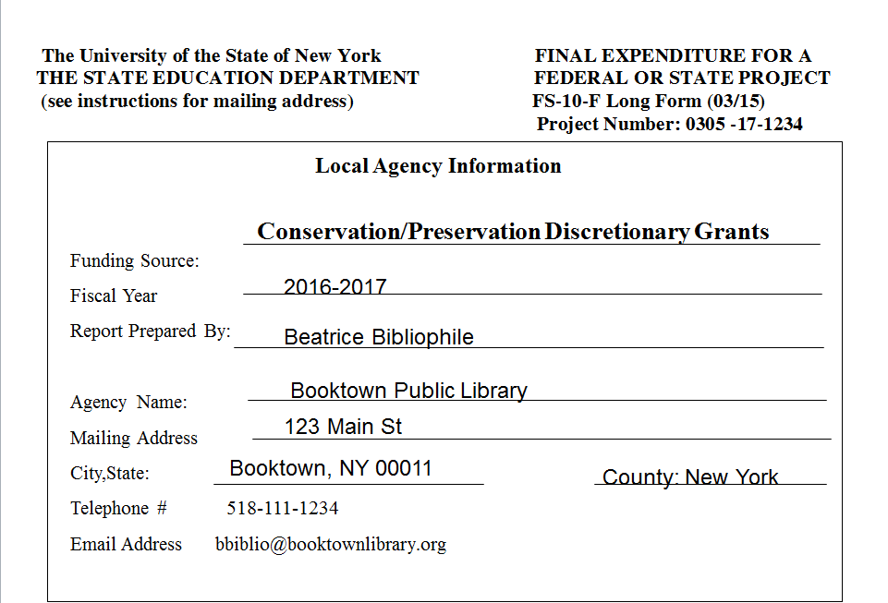
FS-10 Coversheet

Slide 71
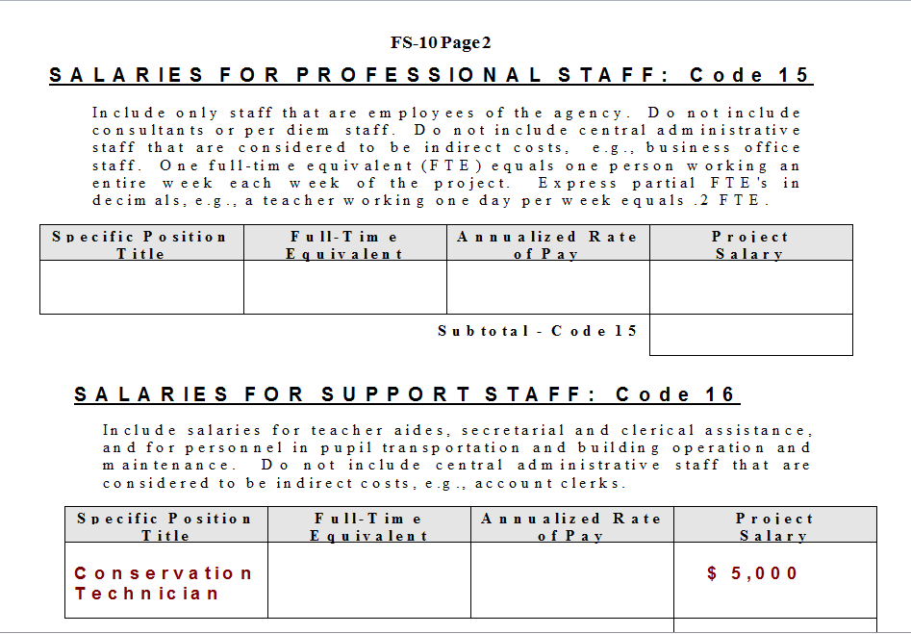
FS-10 p. 2

Slide 72
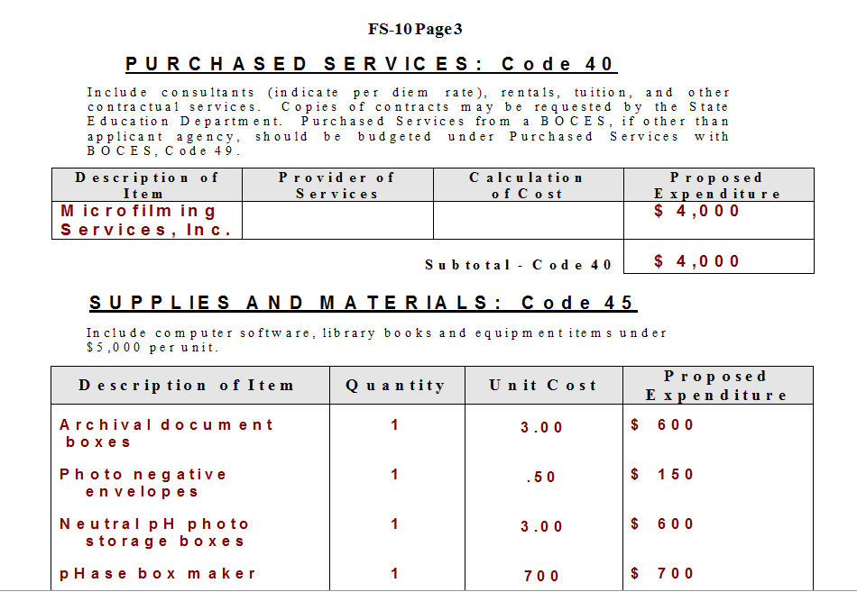
FS-10 p. 3

Slide 73
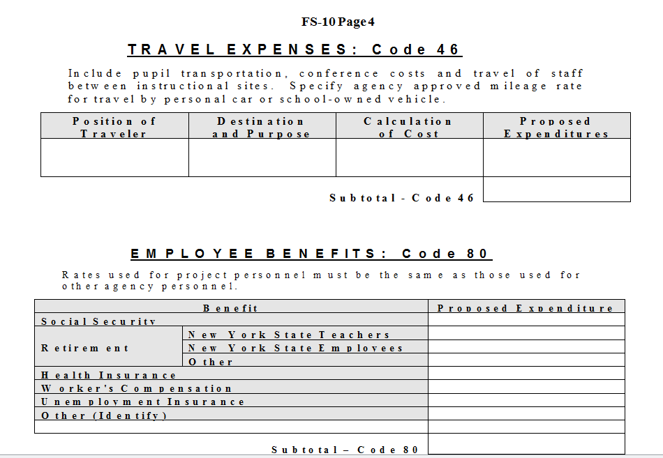
FS-10 p. 4

Slide 74
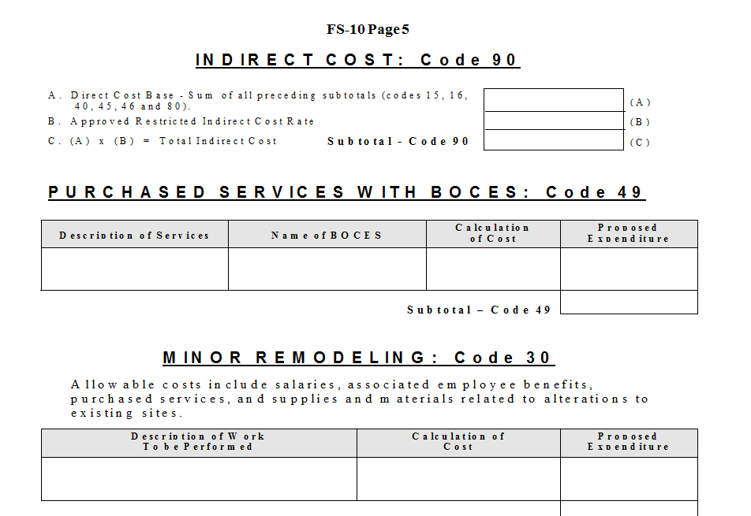
FS-10 p. 5

Slide 75
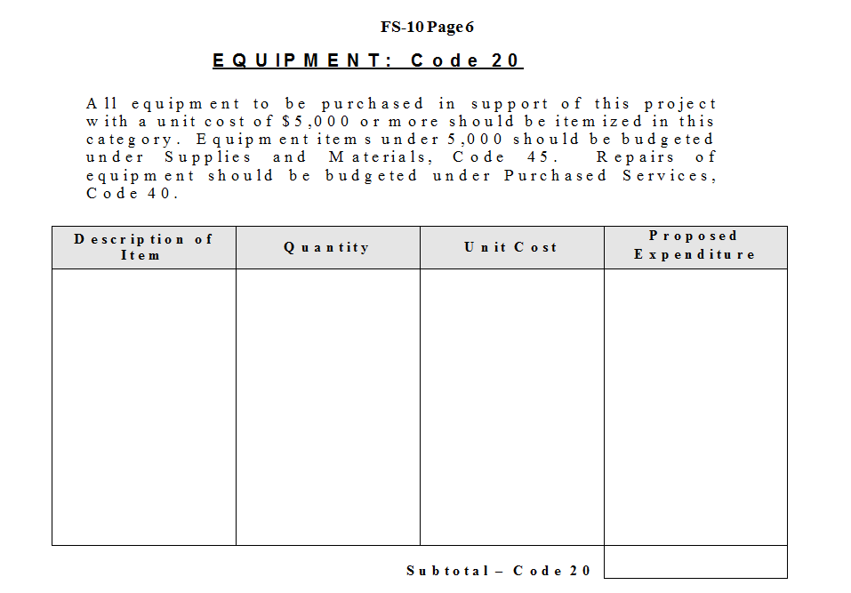
FS-10 p. 6

Slide 76
FS-10 Helpful Reminders
Helpful Reminders
Check for the required number of copies to be submitted, including the number of original signature copies. The number of copies may vary from program to program. If unsure, contact the State Education Department office responsible for the program for which you are applying.
An approved copy of the FS-10 will be returned to the contact person at the address completed on page 1. A window envelope will be used for the return mailing; please make sure that the contact information is accurate, legible, and confined to the address field.
Be sure to check your math and carry all subtotals forward to the Summary on Page 8. Simple mathematical errors often require Grants Finance to contact both the local agency and other State Education Department offices, resulting in unnecessary delays in program approval. And remember, use whole dollars only.
School districts and BOCES should use the restricted indirect cost rate that has been approved for the school year in which the grant will operate. Most other agencies are subject to a fixed maximum rate depending on the grant program and type of agency. Contact Grants Finance at (518) 474-4815 if you have any questions regarding indirect costs.
The modified direct cost used in the calculation of indirect cost must exclude equipment, minor remodeling, the portion of each subcontract exceeding $25,000 and any flow through funds.
Only equipment items with a unit cost of $5,000 or more should be included under Equipment, Code 20.
Be sure to complete the Agency Code and Project # on Page 8 as well as the Project #, if pre-assigned. For Special Legislative projects and Grant Contracts, also enter the Contract #.
For ease of data entry at the State Education Department, please make sure that Page 8 faces out. Submit forms to the State Education Department Program Office as indicated in the application instructions for the grant program for which you are applying. DO NOT submit this form to the Grants Finance Unit.

Slide 77
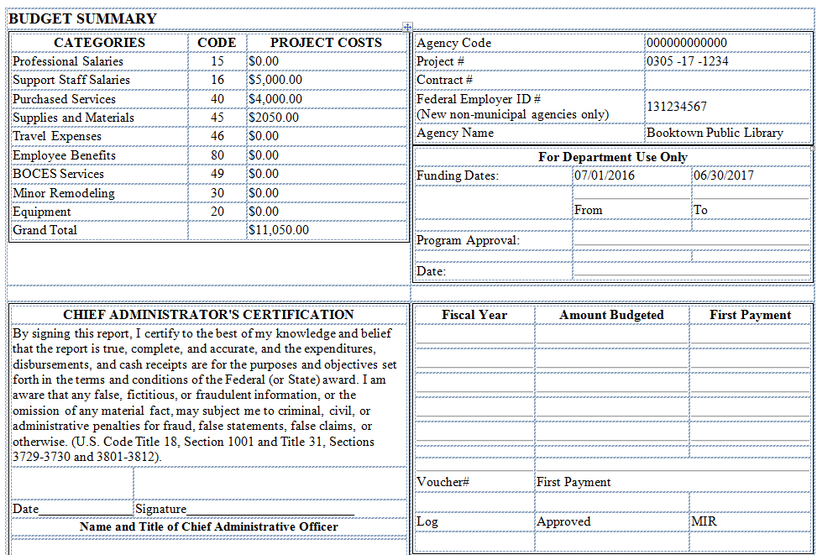
FS-10 p. 8

Slide 78
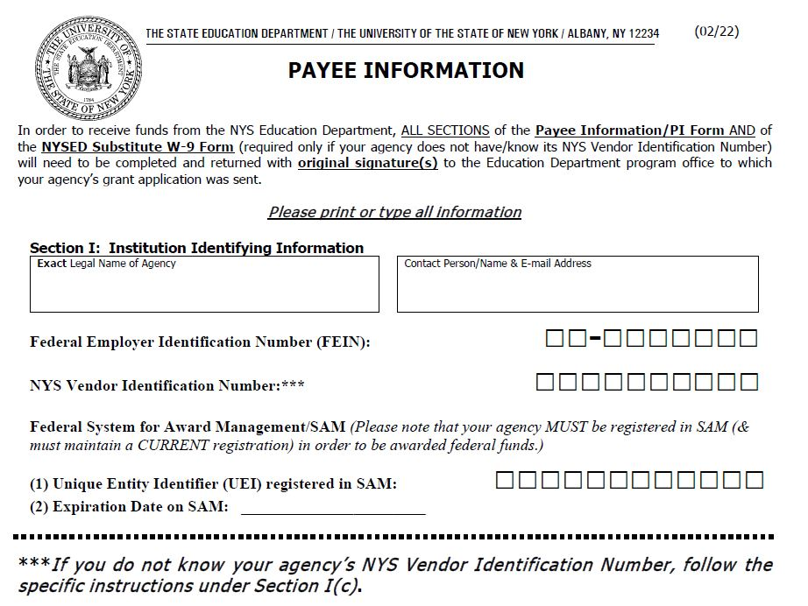
Payee Information Form - 1

Slide 79
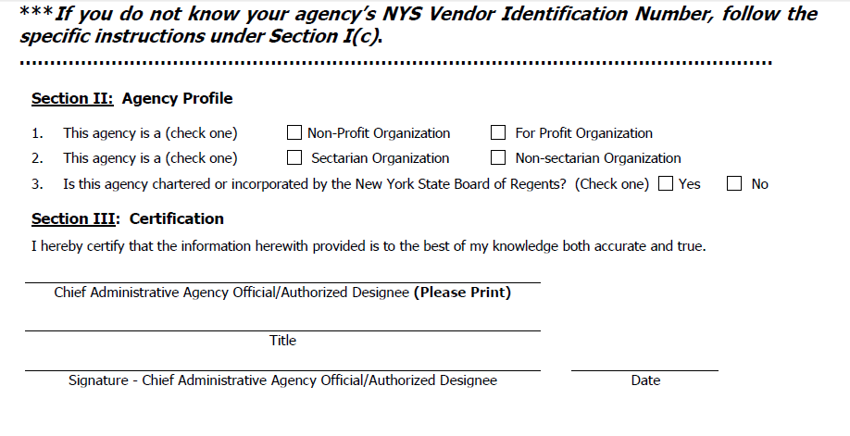
Payee Information Form - 2

Slide 80
M/WBE - 1
All applications for funding over $25,000 are subject to M/WBE requirements. (https://www.nysl.nysed.gov/libdev/mwbe/index.html)
Current M/WBE requirements are 30% of non-personal service budget. M/WBE Certified Directory (https://ny.newnycontracts.com/FrontEnd/searchcertifieddirectory.asp)
Compliance can be achieved in 1 of 3 ways
Full Participation
Request a Partial Waiver
Request a Full Waiver
(Good faith efforts to find applicable M/WBE vendors or suppliers must be documented when requesting either a partial or full waiver)
Complete and upload forms to the online application

Slide 81
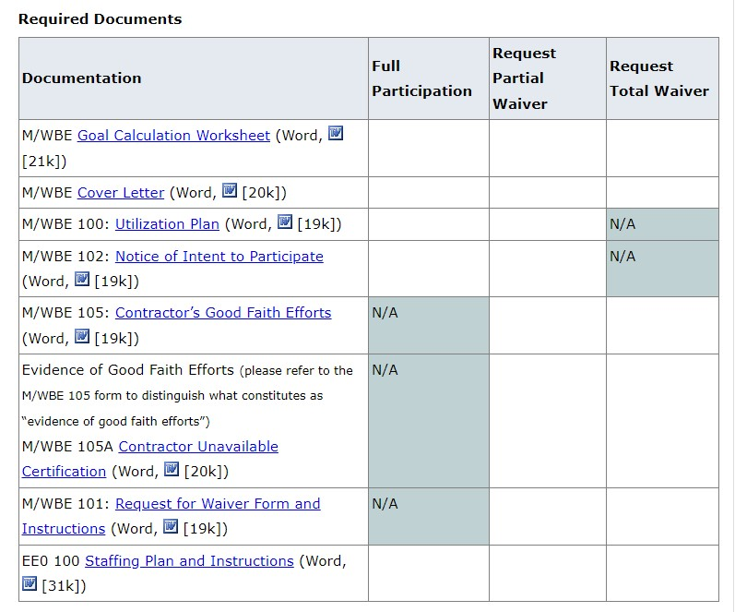
M/WBE - 2
Required Documents

Slide 82
General Reports

Slide 83
Search Discretionary Awards by Year

Slide 84
Search by Keyword in Title

