Slide 1
Understanding OPRHP/SHPO A Primer for Library Construction Projects
The Division for Historic Preservation

Slide 2
State Aid for Library Construction Link
https://www.nysl.nysed.gov/libdev/construc/index.html

Slide 3
Training Agenda
Overview – SED MOU Nancy Herter
Building Search Erin Czernecki
CRIS Steps 1-5 Tim Lloyd
CRIS Step 6 Erin Czernecki
Impact Findings Weston Davey
Questions and Answers

Slide 4
Who We Are
New York State Division for Historic Preservation of the Office of Parks, Recreation and Historic Preservation (OPRHP)
The OPRHP provides state, federal and local agencies with recommendations on how the projects that they are funding, permitting or approving may impact historic and archaeological resources.
Section 106 – National Historic Preservation Act (Federal Actions)
Section 14.09 – New York State Historic Preservation Act (State Actions, like SED)
State Environmental Quality Review Act (Local Actions)

Slide 5
What We Do
The OPHRP in consultation with the involved agencies:
Assists agencies/applicants in identifying historic and archaeological resources.
Determines whether the identified cultural resources are listed in or eligible for inclusion in the New York State and National Registers of Historic Places.
Determines if the action will have an adverse impact on historic resources.
Assesses potential alternatives that might avoid or lessen any identified adverse impacts to historic properties.
Determines how best to mitigate the adverse impact using appropriate mitigation measures, if no reasonable alternatives exist

Slide 6
State Education Department/OPRHP Memorandum Of Understanding (Nov 2017 to Nov 2022) Purpose: To exempt from State Historic Preservation Act Review, Section 14.09 certain categories of building construction/rehabilitation activities funded, undertaken or permitted by SED https://www.p12.nysed.gov/facplan/documents/MOU-StateEducationDepartment-SchoolConstructionandLibraryGrantAgreement-SED-11-6-2017.pdf

Slide 7
OPRHP/14.09 Review Exemptions
Activities that are exempt includes those that have been determined to have little or no potential to impact historic buildings/structures and archaeological sites
Construction work categories exempt from OPRHP review can be found in Attachment 1 of the MOU

Slide 8
Major Exempt Categories
Site Work/Archaeology
Activities with little potential to impact the ground surface
In Kind construction activities: proposed length, width and depth does not exceed the original length, width, and depth of previous ground disturbance
Buildings/Structures
Buildings/structures that are 50 years old or less at the time of the project scope start
Buildings/structures over 50 years of age previously determined by OPRHP to not be National Register eligible
Activities with little or no potential to affect the historic character of buildings/structures

Slide 9
Determining Building/Structure OPRHP Status cris.parks.ny.gov

Slide 10
CRIS

Slide 11
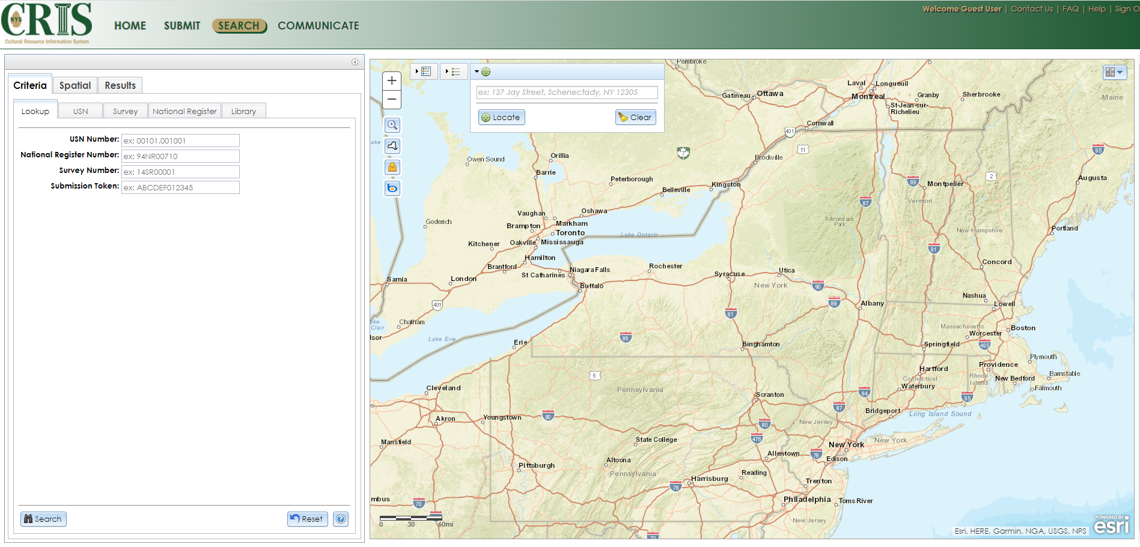
Building Search by Address

Slide 12
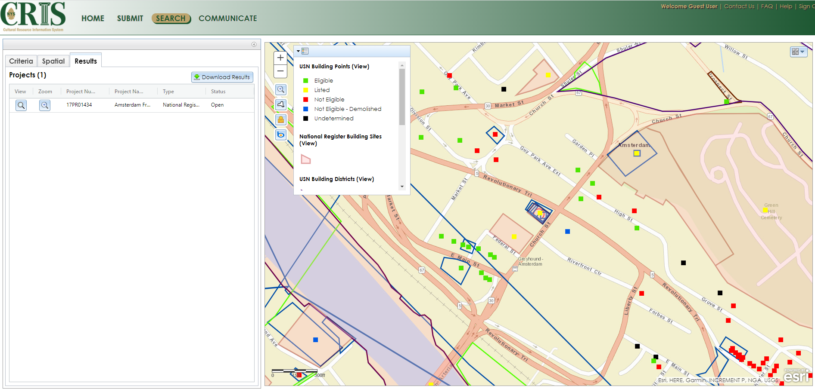
Building Search by Address: Building Symbols

Slide 13
CRIS Submission Process
For each request to review and comment by OPRHP, the Applicant will submit their project information utilizing OPRHP’s CRIS project submission portal.
The system guides the applicant through uploading project specific information.

Slide 14
Click Consultation

Slide 15
Click Start New Consultation Submission

Slide 16
1. Contact Information

Slide 17
2. Project Overview

Slide 18
3. Agency Information 4. Project-Level Attachments

Slide 19
5. Project Location

Slide 20
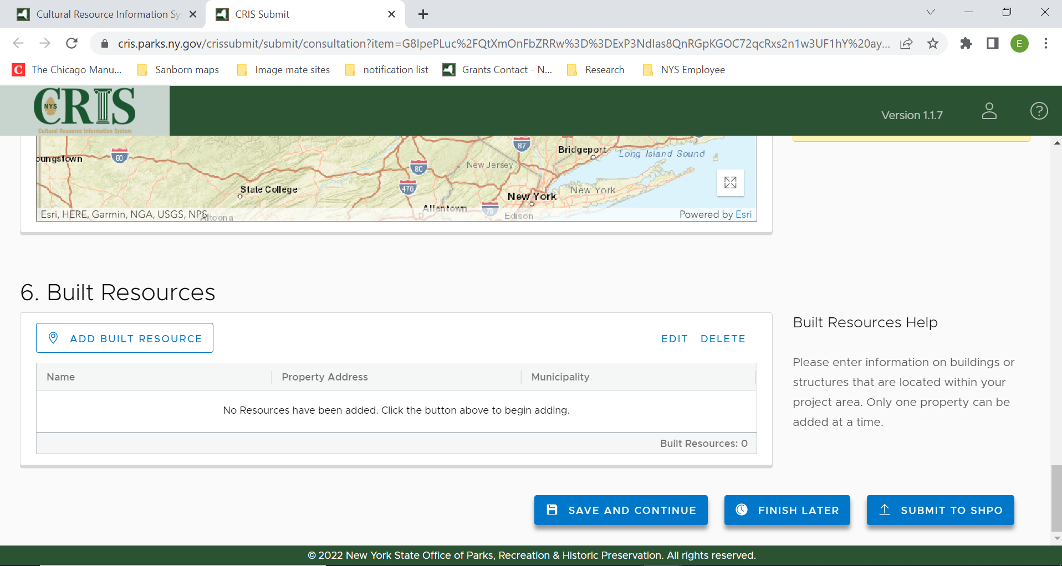
6. Built Resources

Slide 21
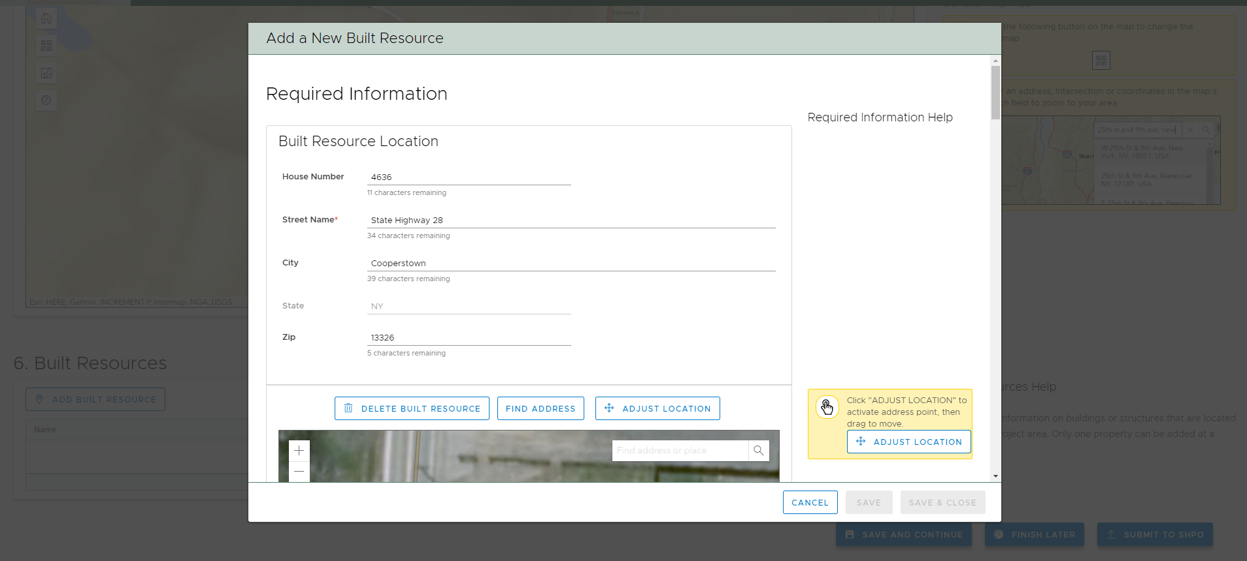
Address

Slide 22
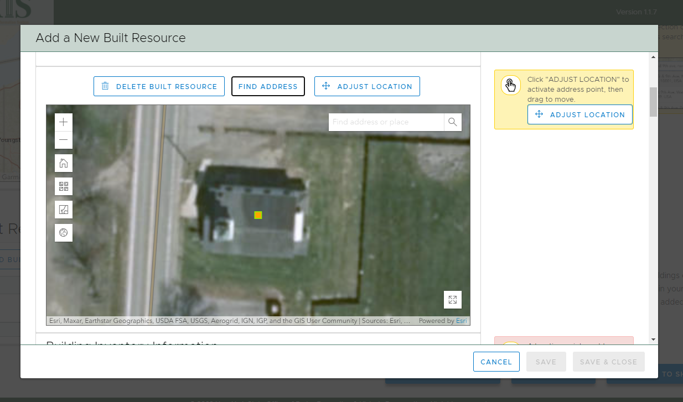
Location

Slide 23
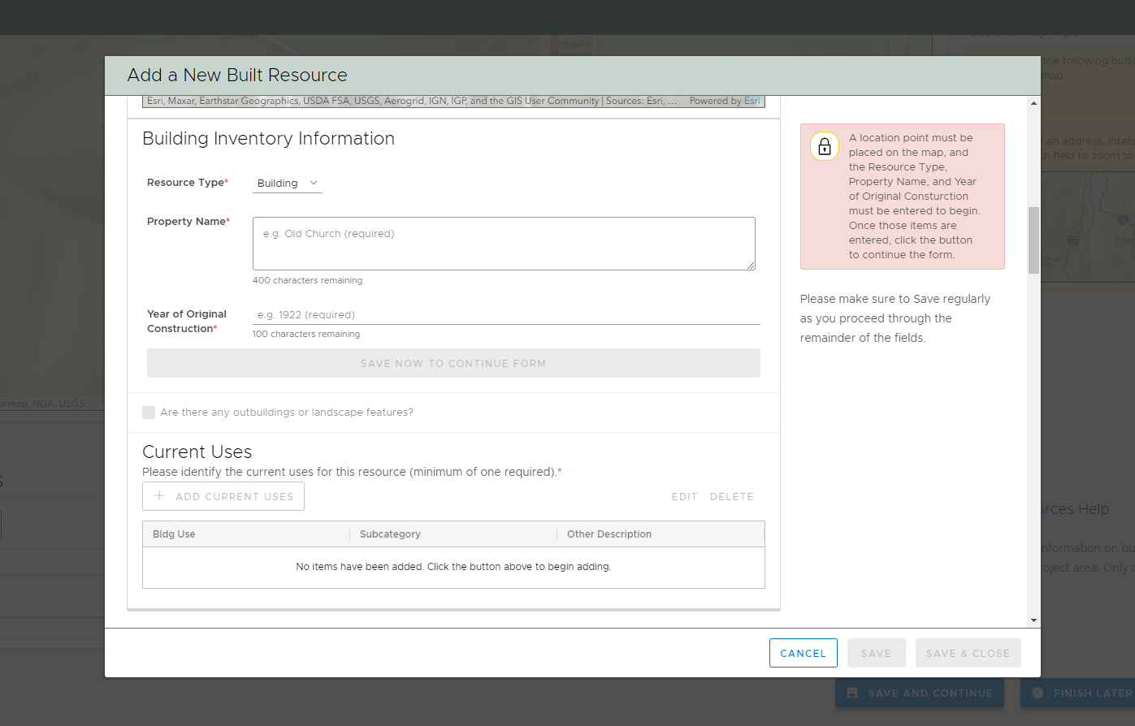
Building Information

Slide 24
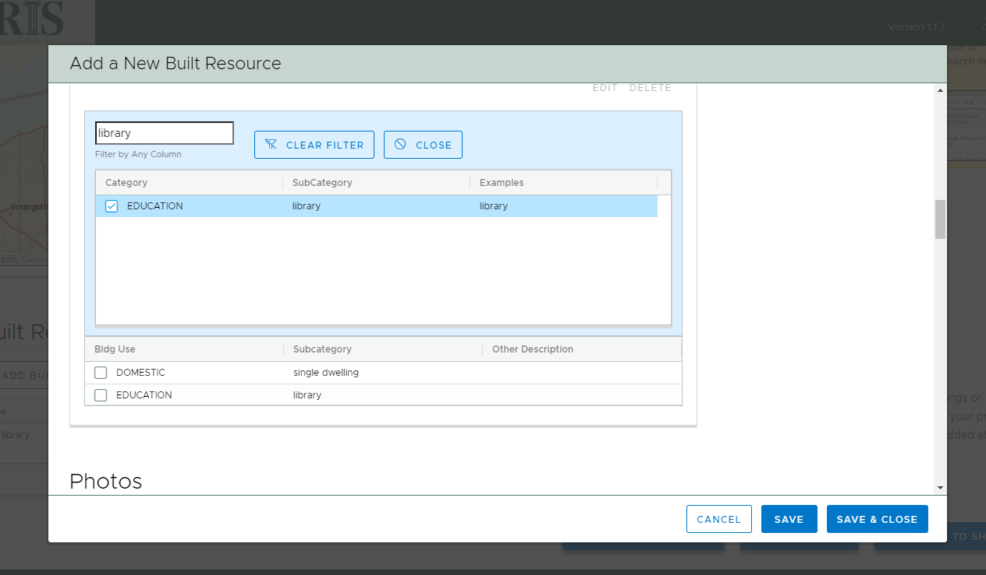
Current Use

Slide 25
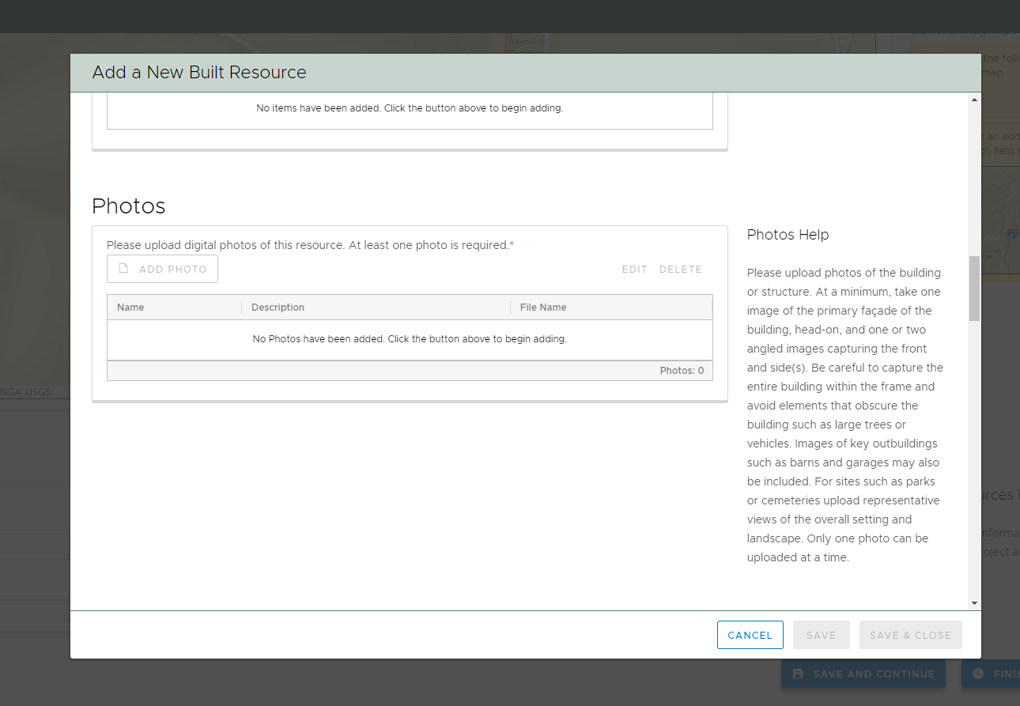
Photos

Slide 26
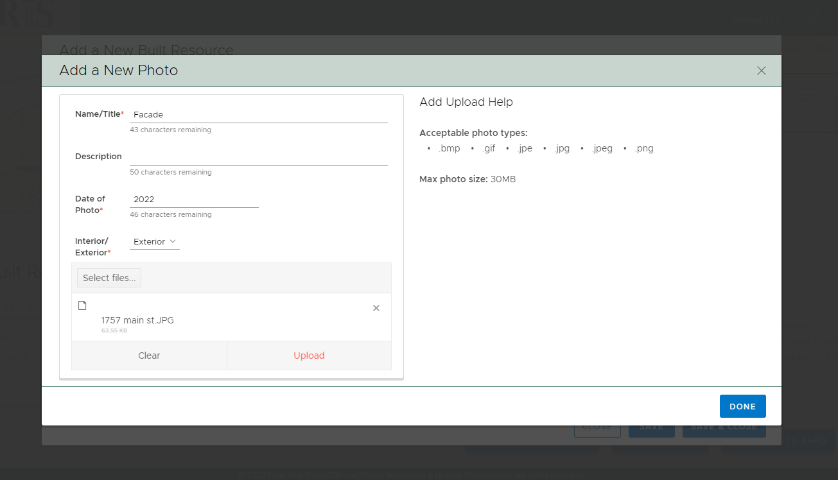
Photos (2)

Slide 27
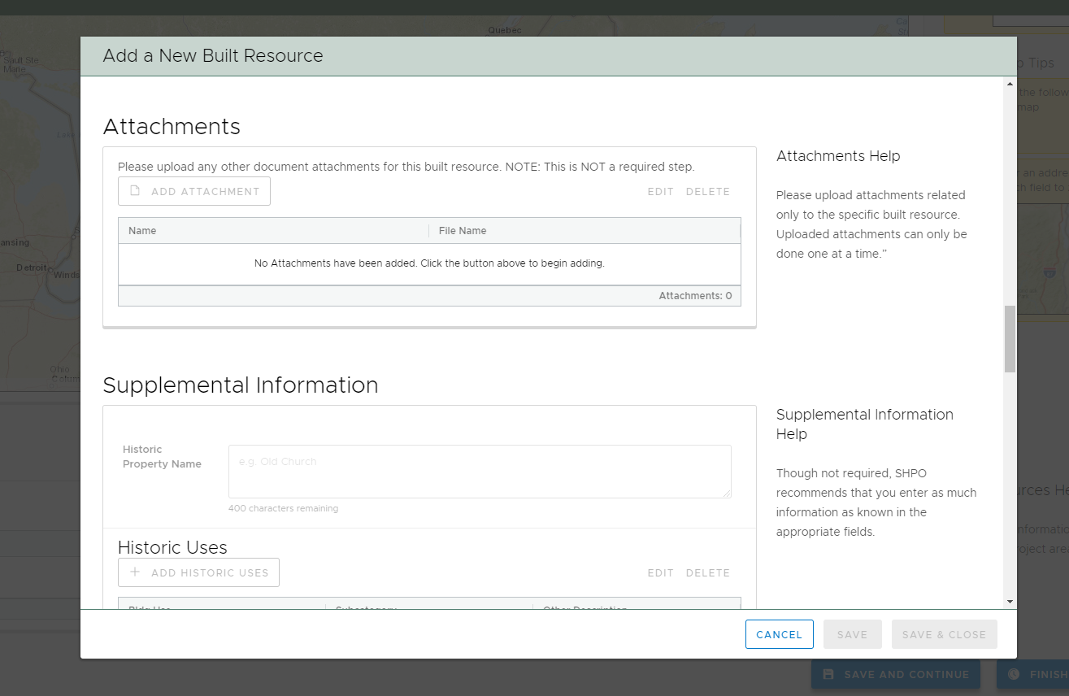
Attachments Supplemental Information

Slide 28
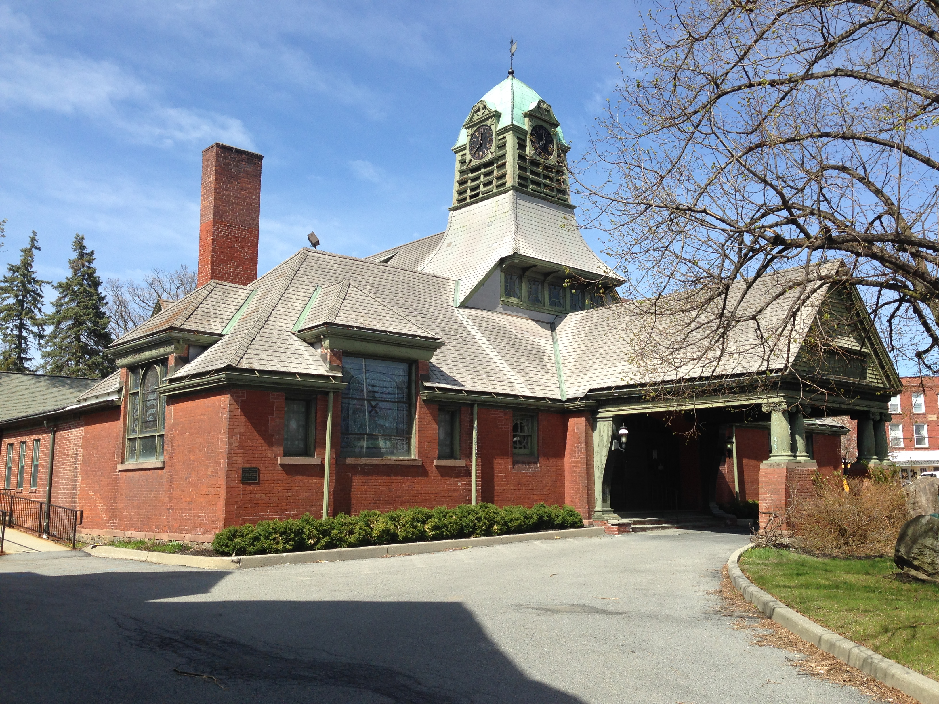
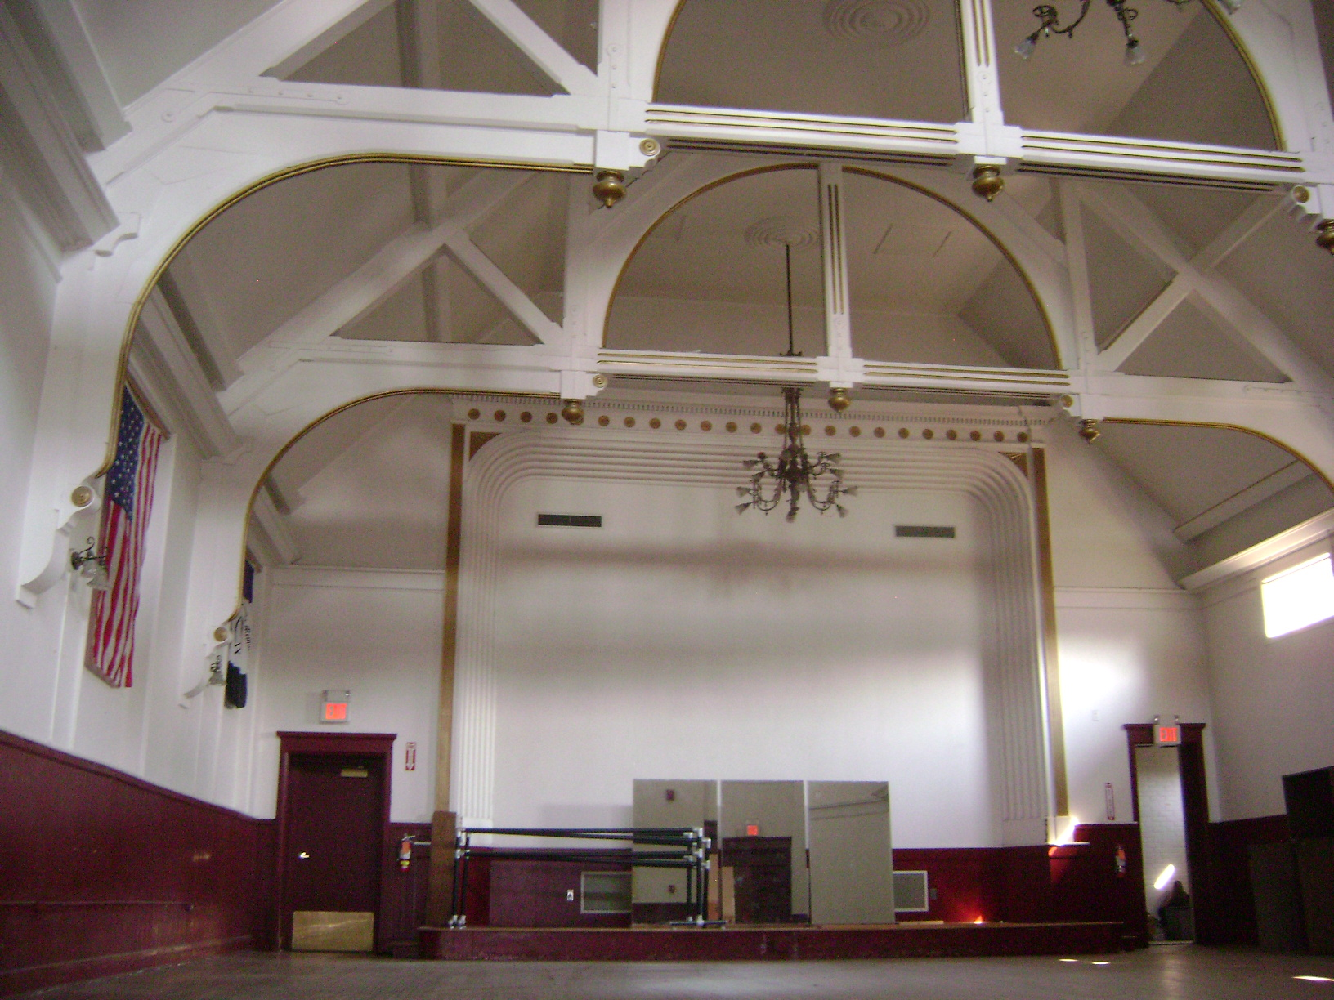
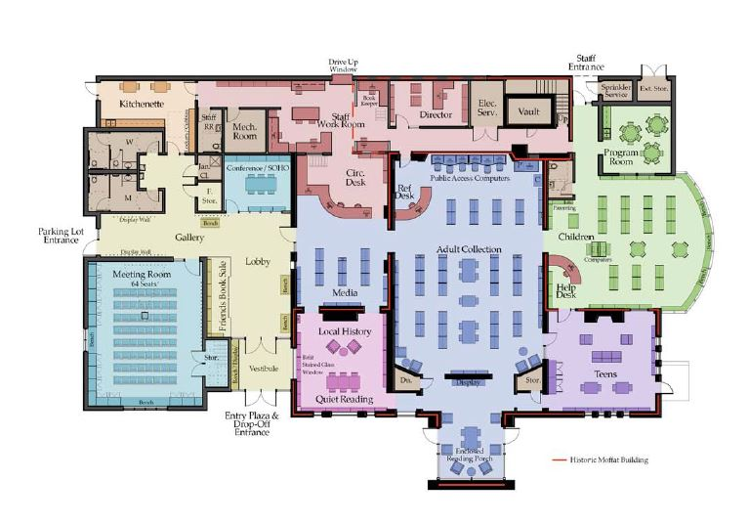
Historic Building Technical Review Project-level Attachments (CRIS Step #4)
Photographs:
Include a key plan and/ or a photo log
Take overall photos of the building and details showing historic features and areas where work will take place
Pro tip: combine photos as a PDF, create PPT slideshow and save as PDF, or upload as .zip file
Narrative/ Scope of Work:
The narrative should clearly describe the condition of the existing historic property, as well as proposed work, including the specific materials and methods of repair.
The narrative should be as concise as possible
Plans:
Elevations, floor plans, site plans, existing and proposed plans, etc. Level of detail depends on the nature of the work
Not always required for very simple projects

Slide 29
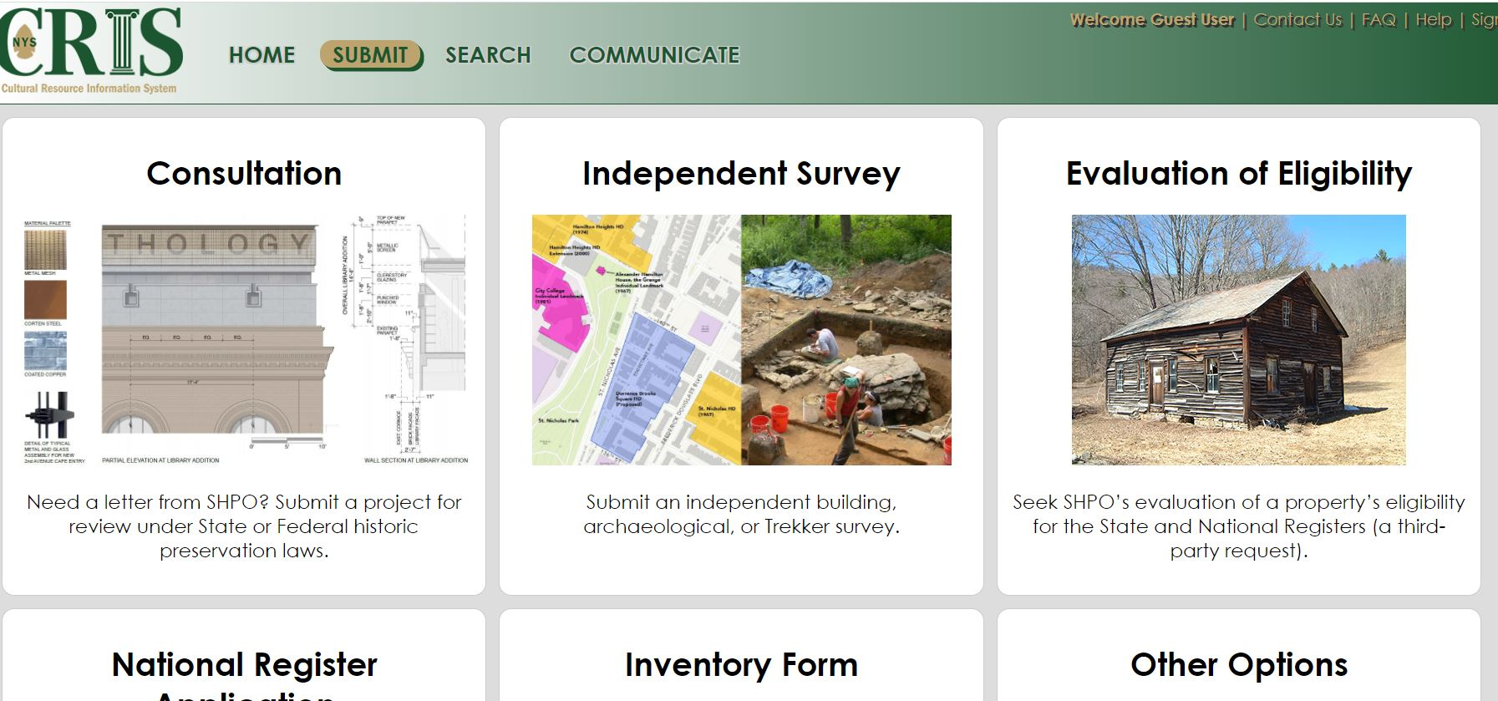
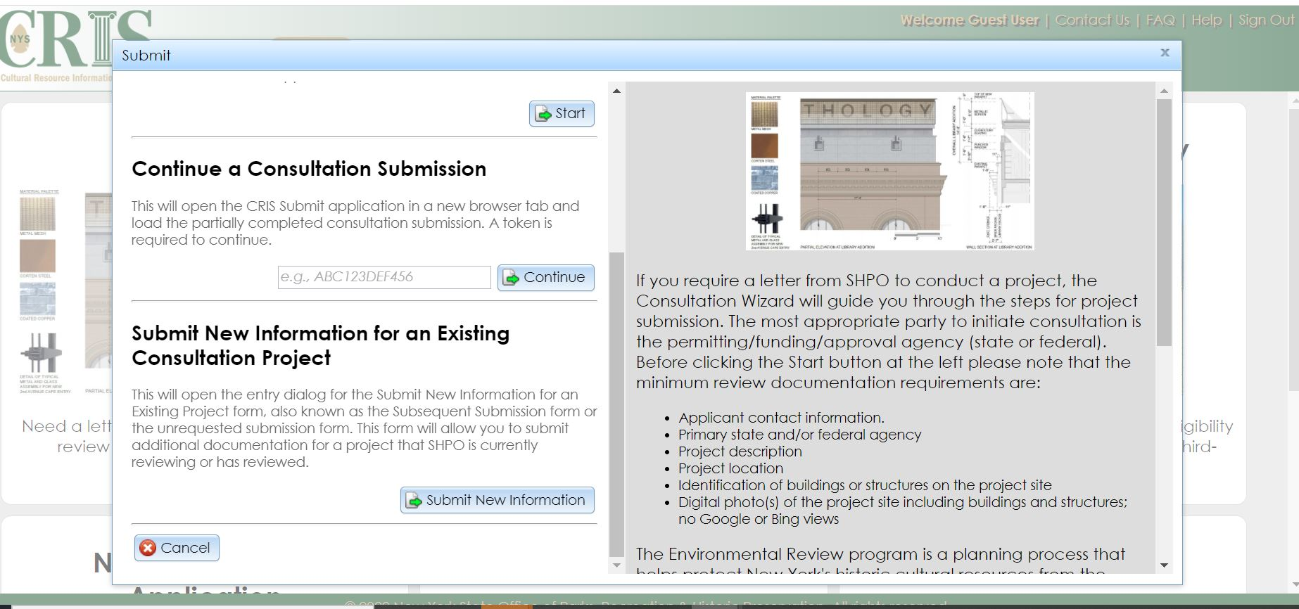
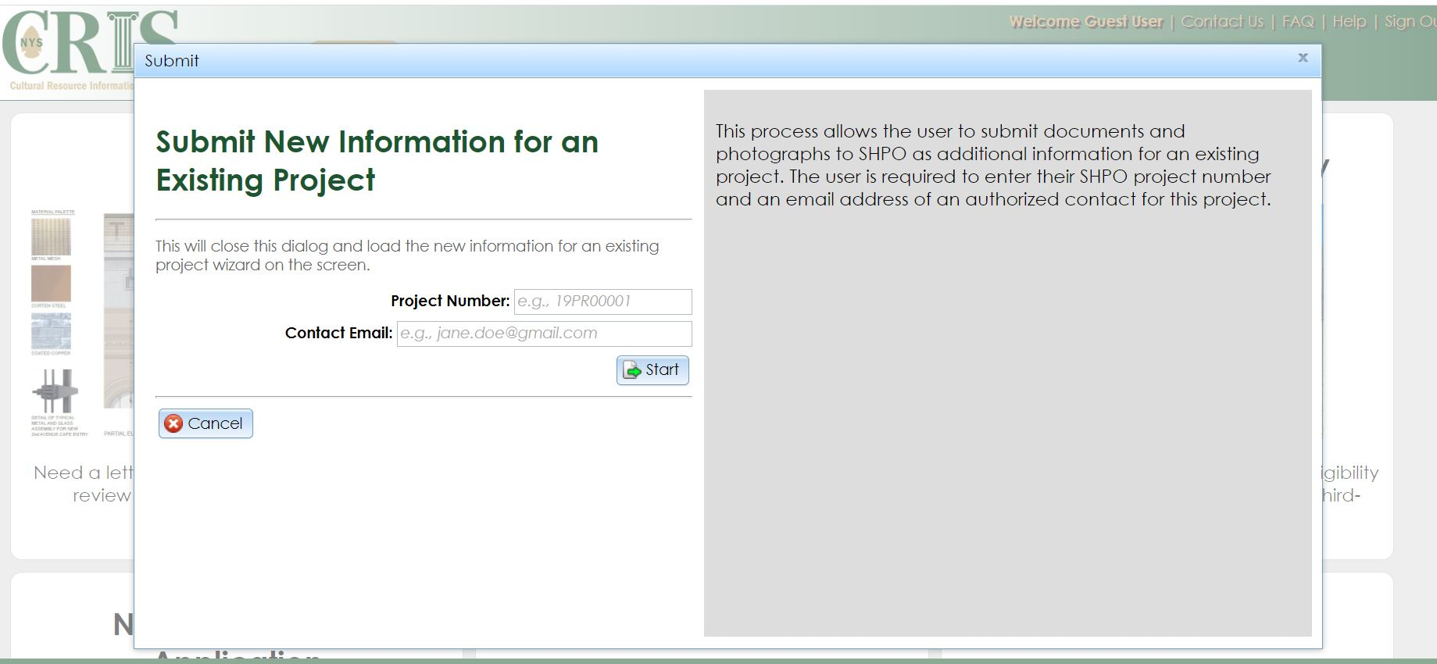
Submit New Information for an Existing Project
https://cris.parks.ny.gov/

Slide 30
OPRHP Review Process Completion
Impact Determinations
● No Historic Properties* Impacted/Process Ends
No Historic Properties Present
● No Adverse Impact/Process Ends
Historic Property Present but No Adverse Impact
● No Adverse Impact /With Conditions/ Process Ends
Continued consultation may be required
● Adverse Impact/Letter of Resolution/Process Ends
Historic Property Present & Historic Character Adversely Impacted
*A Historic Property is a building, structure, object, site or district listed in or eligible for the National Register of Historic Places

Slide 31
Questions and Answers

